Slide 1
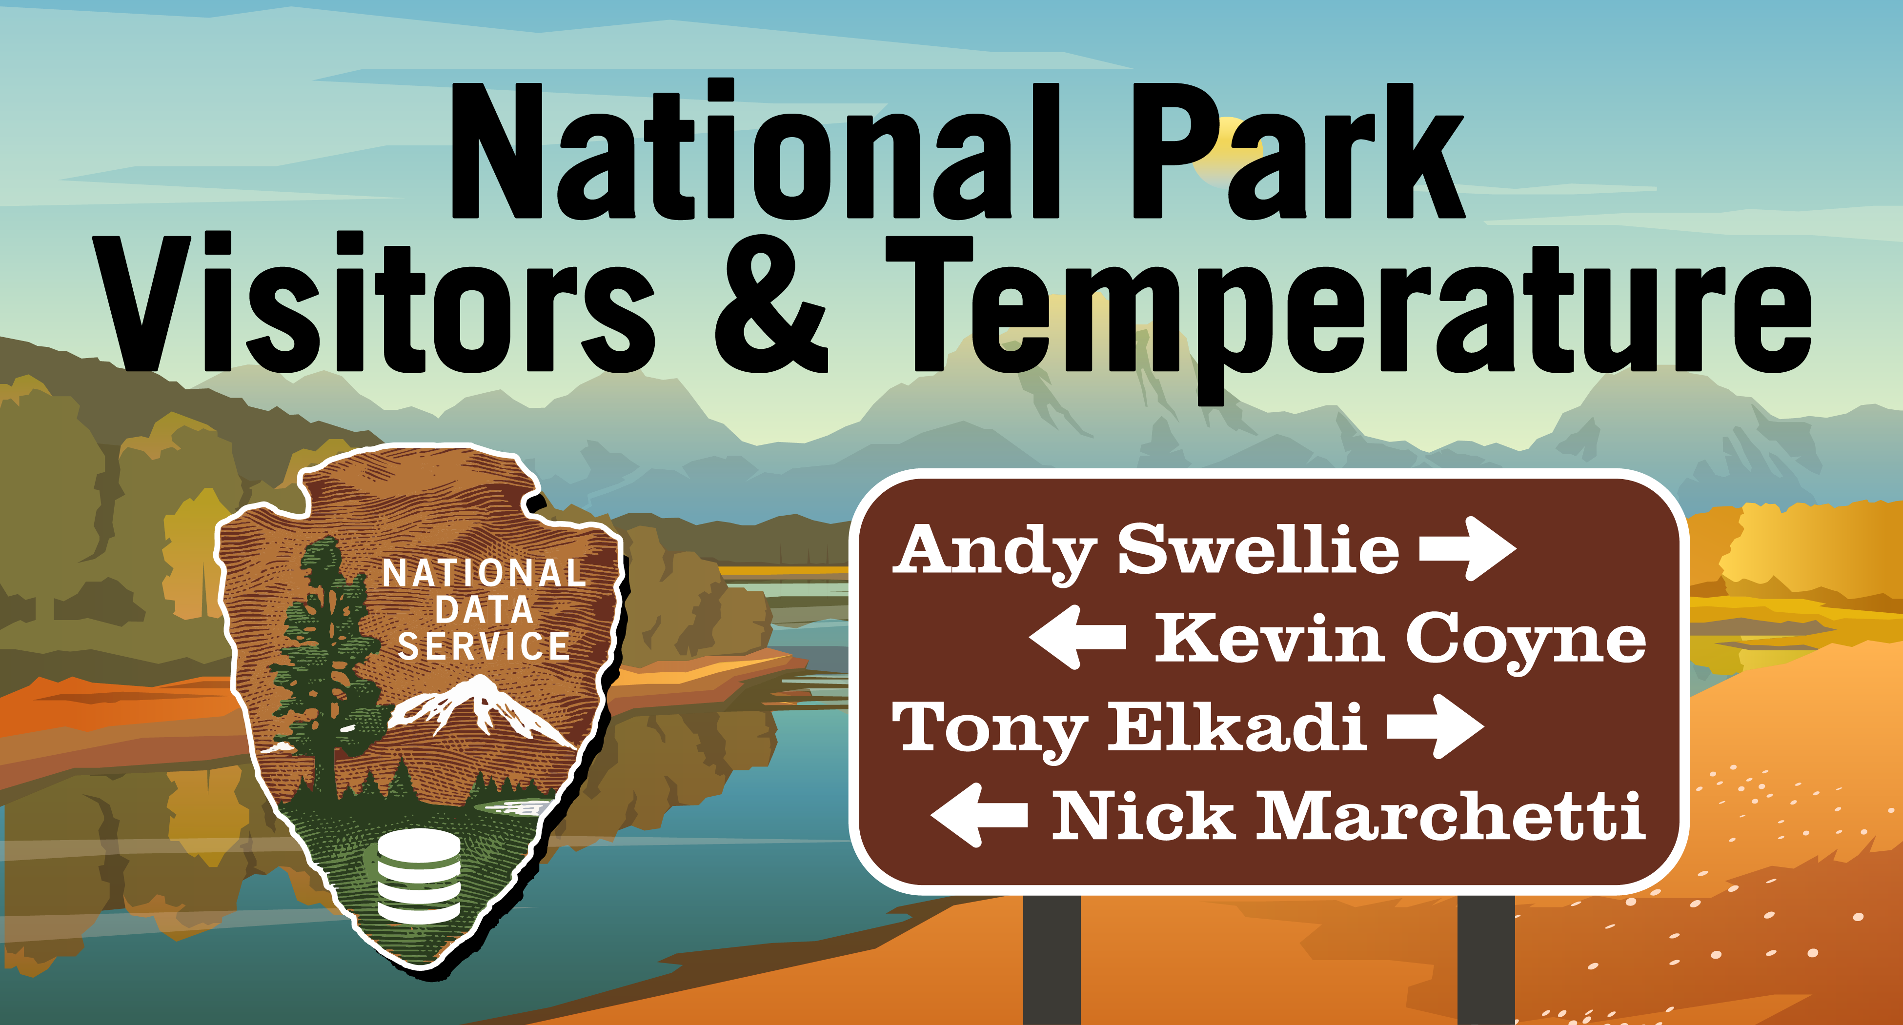
Notes:
Andy

Slide 2
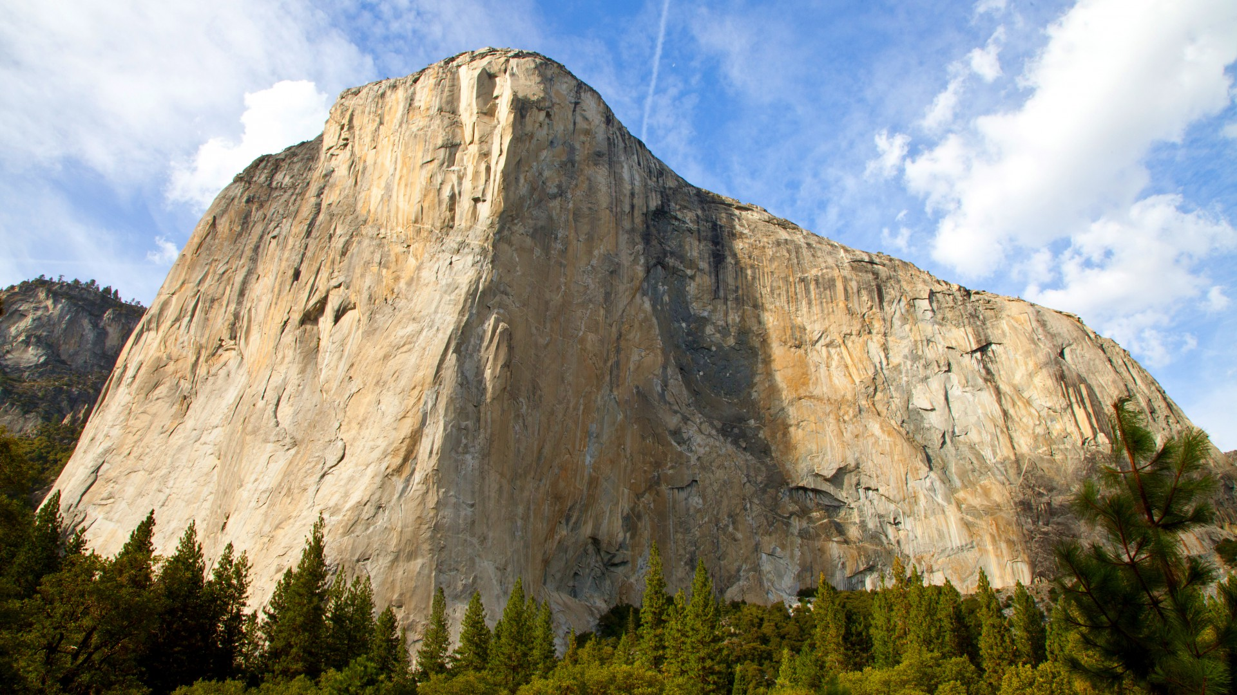
There is no correlation between average annual temperature increase over the last 10 years in our nations 10 most visited parks and the average annual increase in number of visitors to those parks
Increasing average annual temperatures over the last 10 years in our nations 10 most visited national parks have caused more people to visit those same parks
Our goal was to determine first if the average annual temperature in our nations 10 most visited national parks has been increasing over the last 10 years. Next we wanted to determine if recreational visits to those same parks also increased over the same time period. Finally, we wanted to see if there was any correlation between those two data points.
Notes:
Nick

Slide 3
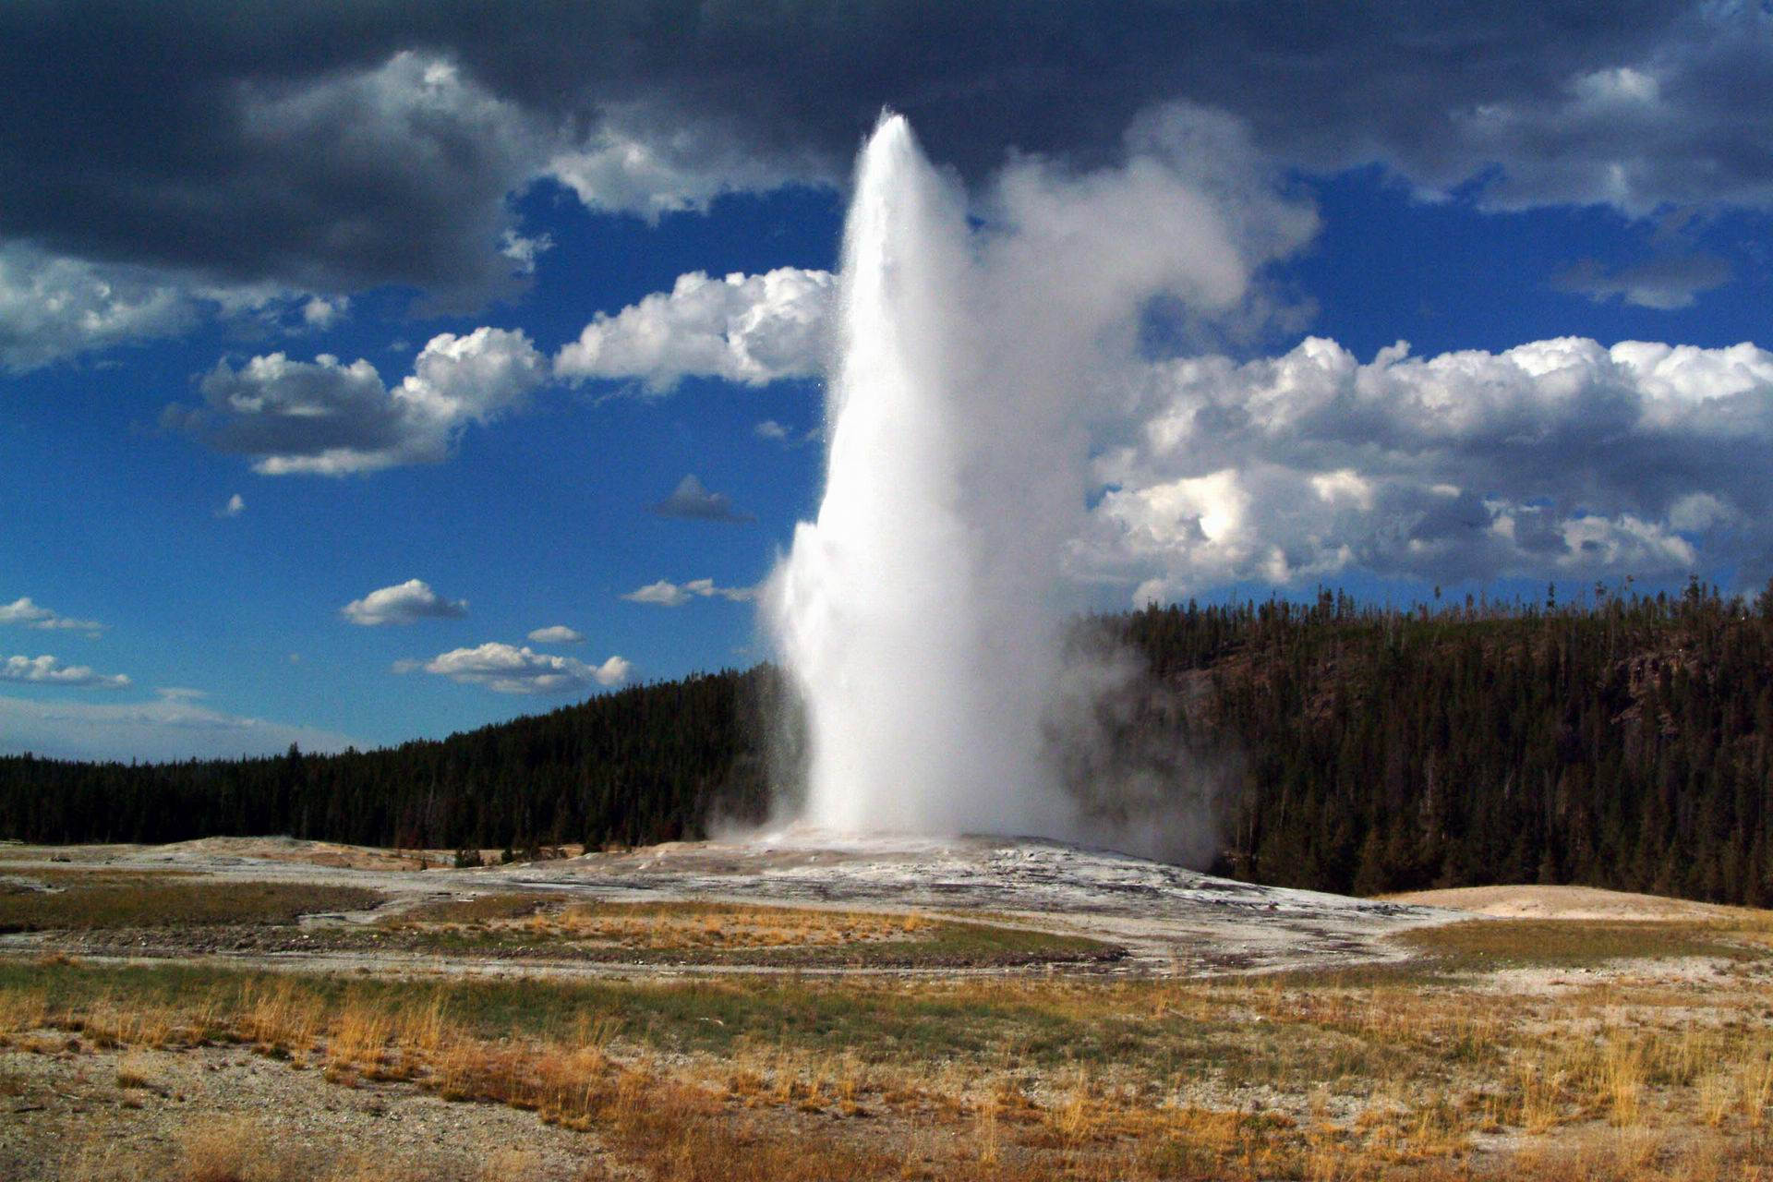
Through our research we found that the top 10 most frequently visited parks are:
Acadia, Glacier, Grand Canyon, Grand Teton, Great Smokey Mountains, Olympic, Rocky Mountain, Yellowstone, Yosemite, and Zion National Parks
We also found that over the last 10 years the average visitors per month to these parks has increased by ~31%
Average annual temperature has also increased by 2.2 degrees over the last 10 years
We also found that there is a statistically significant correlation between these two variables!
Given more time and resources we would explore the relationship between increasing average annual temperatures and the increase in visitors to parks by expanding our scope to include the last 50 years or more and all 58 park locations as well as additional weather conditions such as humidity
Notes:
Tony

Slide 4
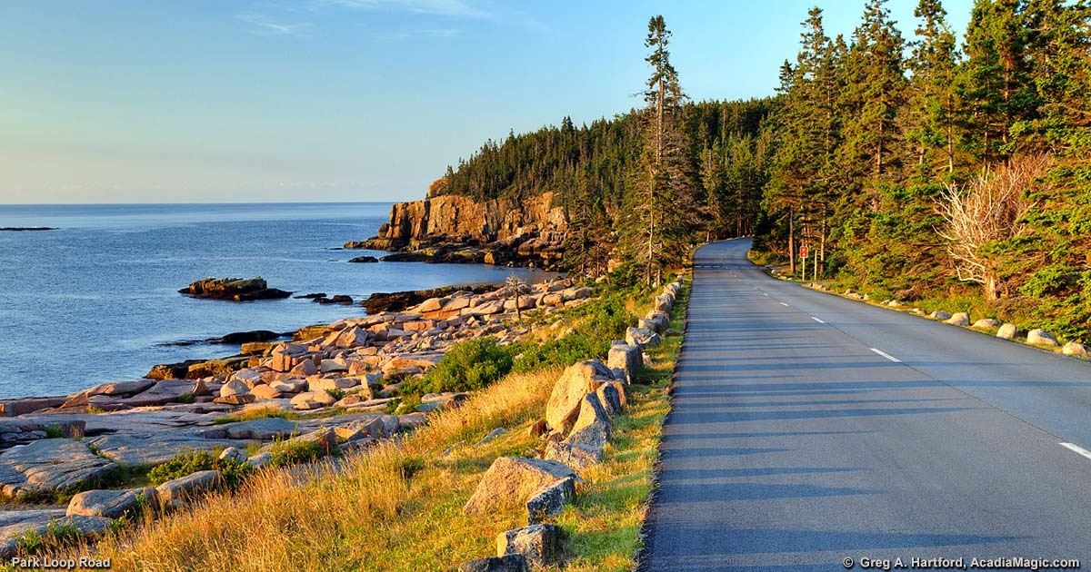
What are the 58 U.S. National Parks and where are they located?
US National Parks API
G-Maps
How many recreational visitors has each of these parks had each month for the last 10 years?
National Park Service International Resource Management Application (IRMA) Portal
What are the top 10 most visited parks?
National Park Service International Resource Management Application (IRMA) Portal
What was the monthly average temperature for the last 10 years in those parks?
Dark Sky API
Notes:
Kevin

Slide 5

Identify all 58 National Parks and pull their latitudes and longitudes
Pull recreational visitors by month for all parks from 2009 – 2018
Identify the 10 most frequently visited parks & map them
Identify a weather API that would allow us to pull historic data
Call the weather API and pull temps for every other day from 2009 – 2018 for each of our 10 locations
Calculate average temps by month for all locations
Combine all data into one data frame and create many different GroupBy objects to help answer our questions
Generate multiple visualizations to help us understand what was actually happening
Analyze the results and provide a conclusion
Notes:
Andy

Slide 6

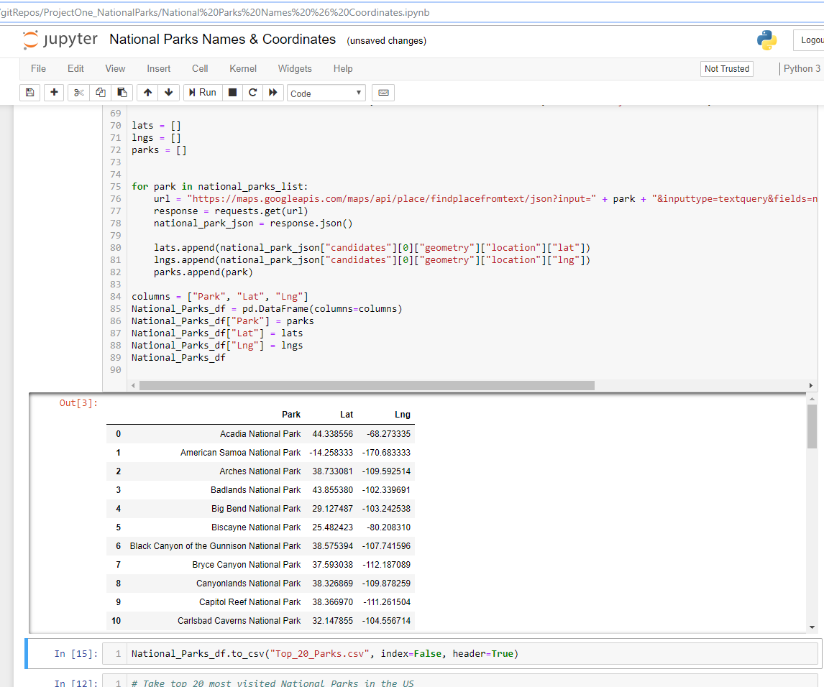
Step 1: Identify all parks and get their latitude and longitude
Notes:
Tony

Slide 7
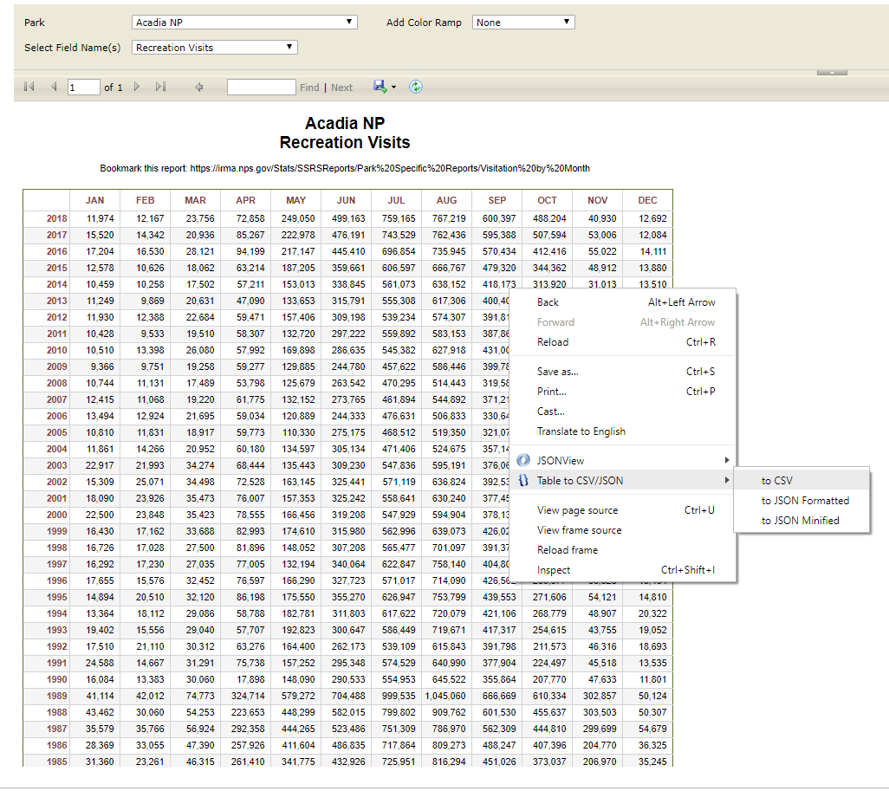
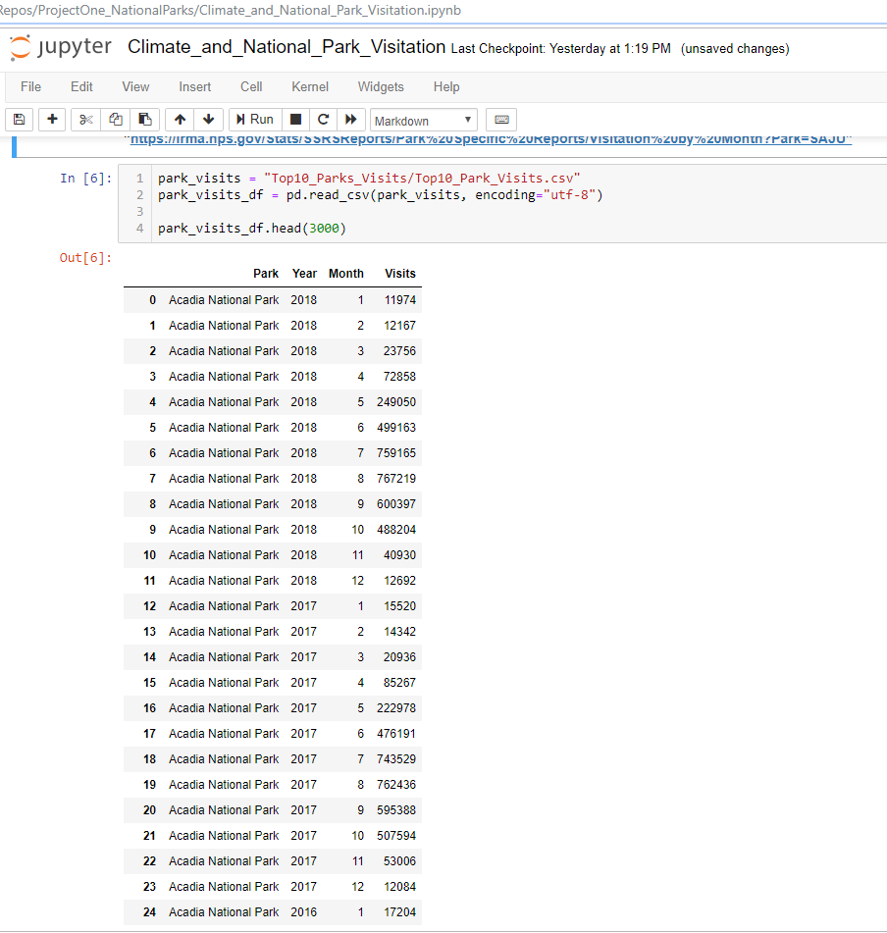
Step 2: Pull visitors by month from 2009 to 2018 for all parks and create a data frame of the 10 most visited
Notes:
Andy

Slide 8
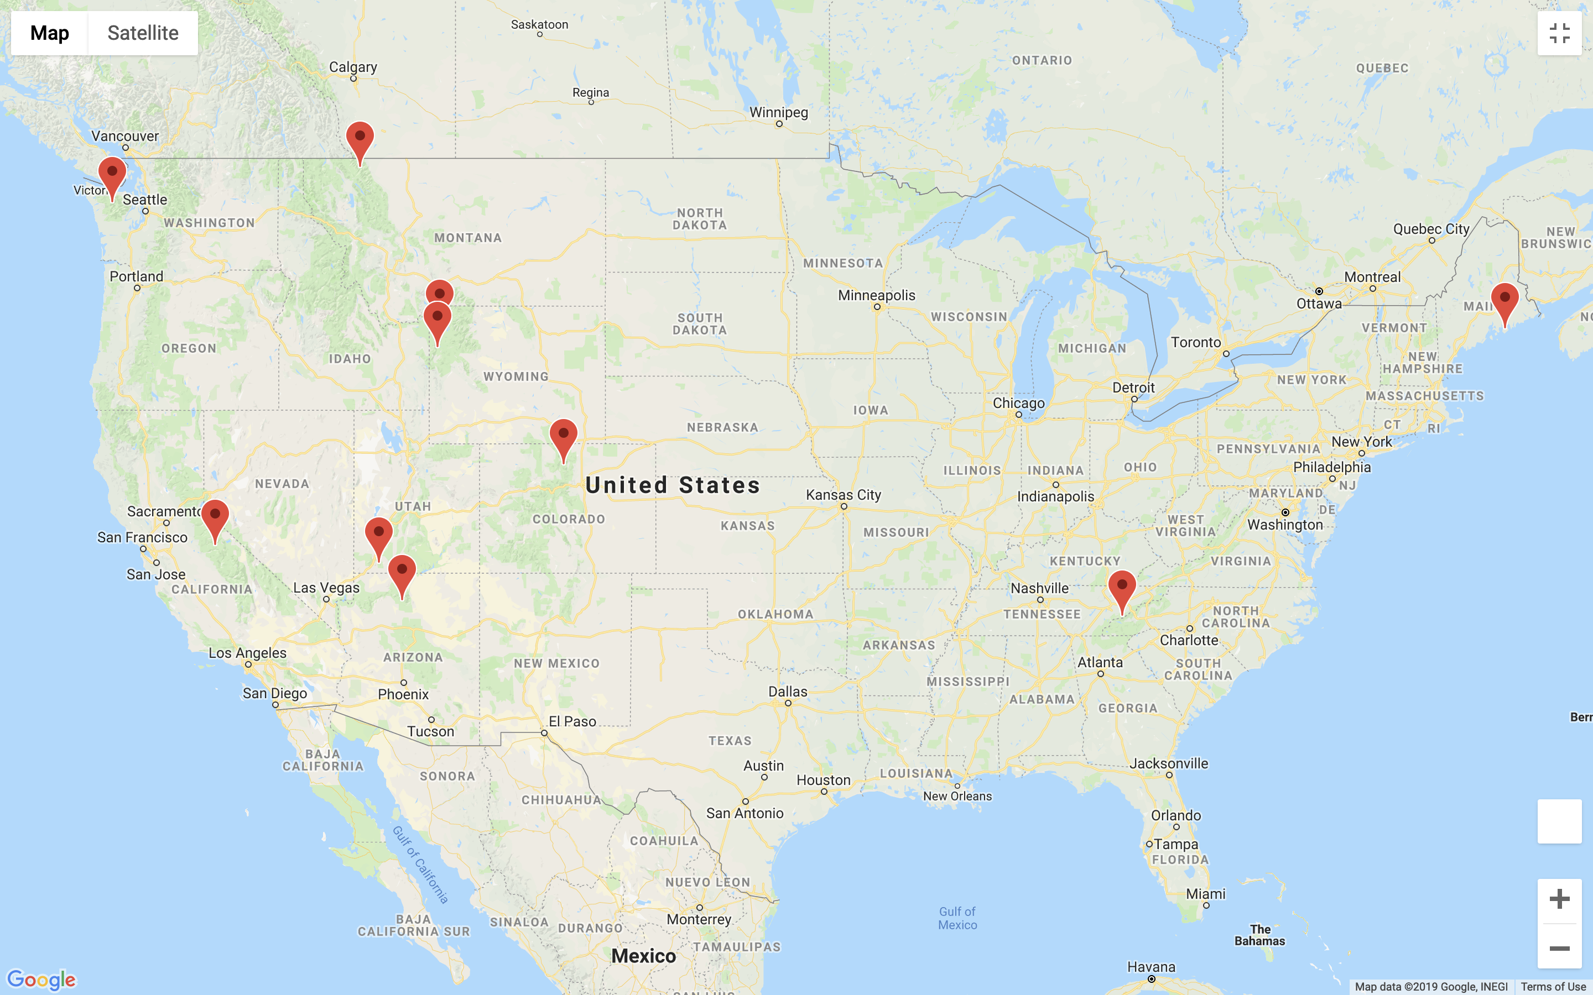
Step 3: Map the 10 most visited parks
Notes:
Kevin

Slide 9
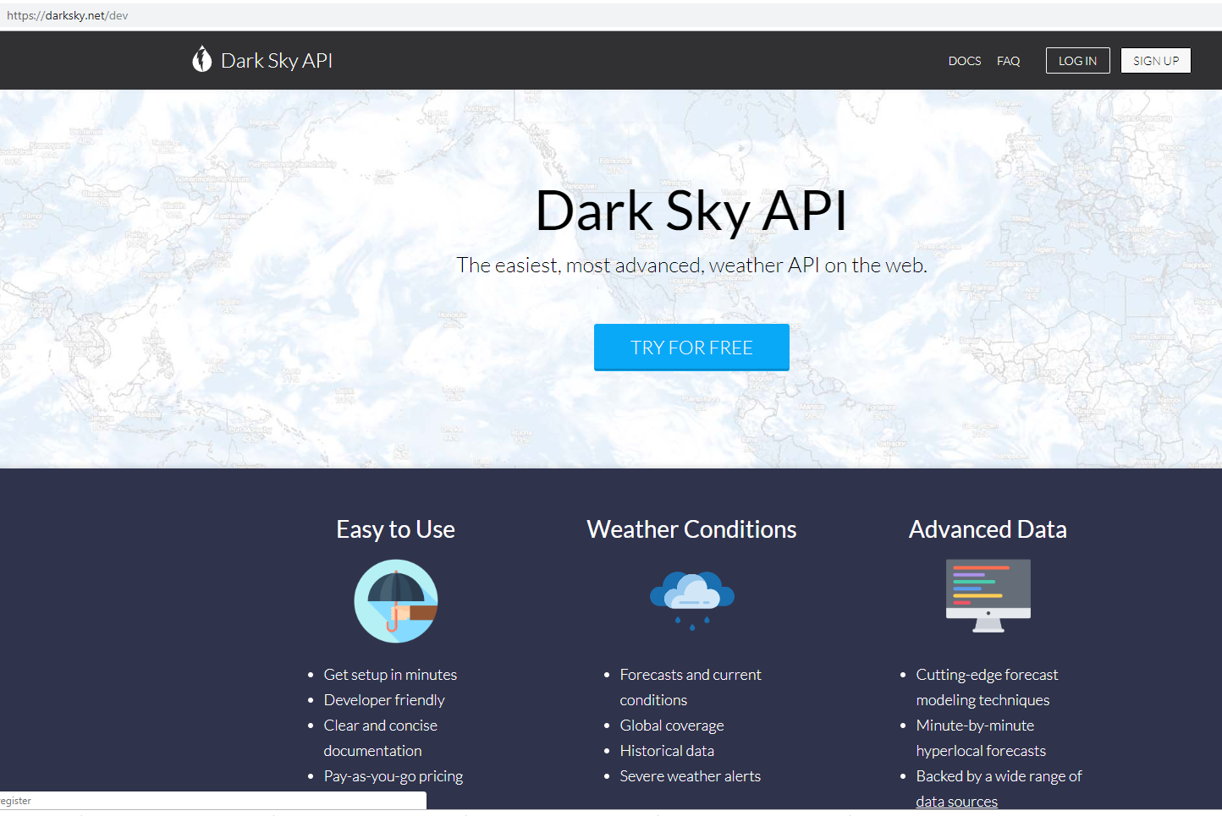
Step 4: Identify a weather API that gives historical data
BOO!!!
YAY!
Notes:
Kevin

Slide 10
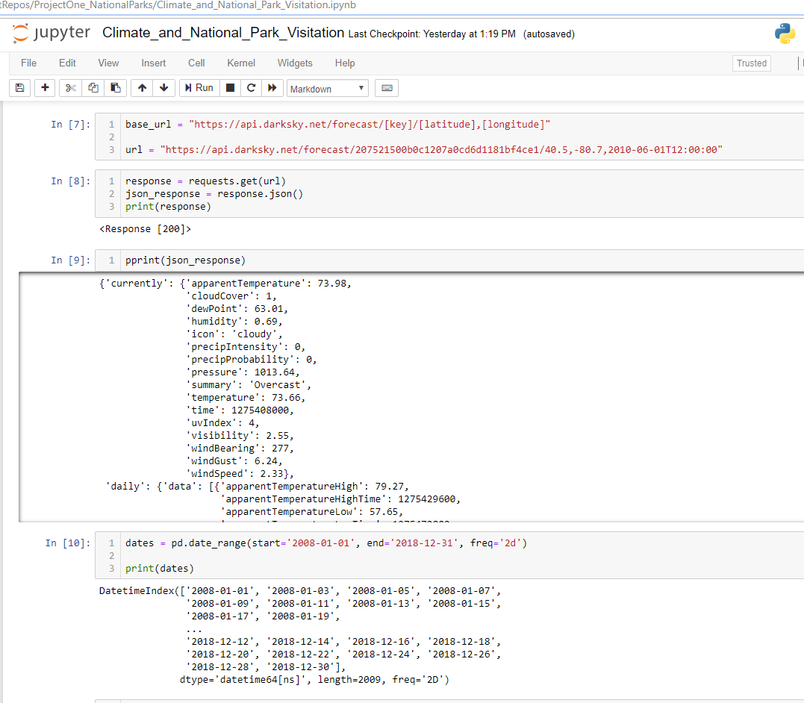
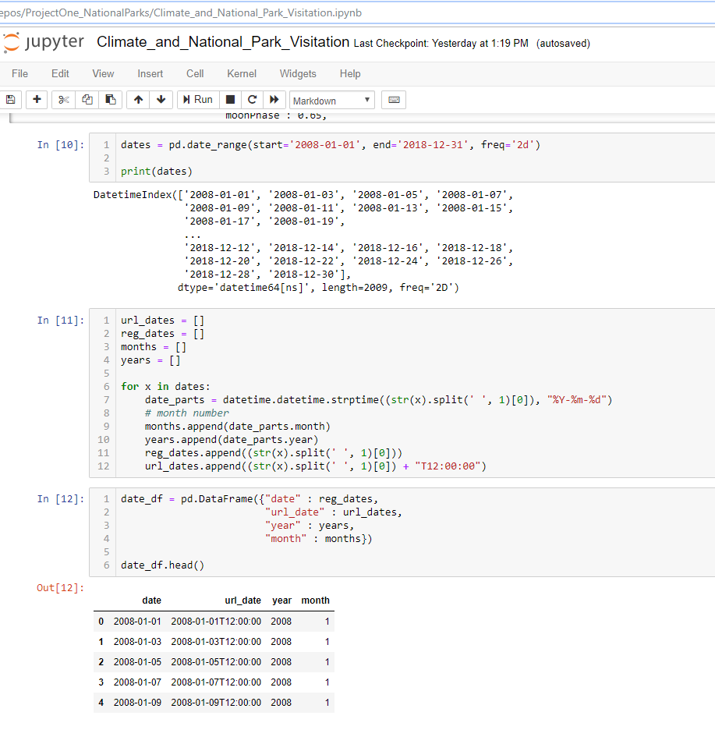
Step 5: Generate a list of dates for every other day for the last 10 years to limit our API calls
Notes:
Nick

Slide 11
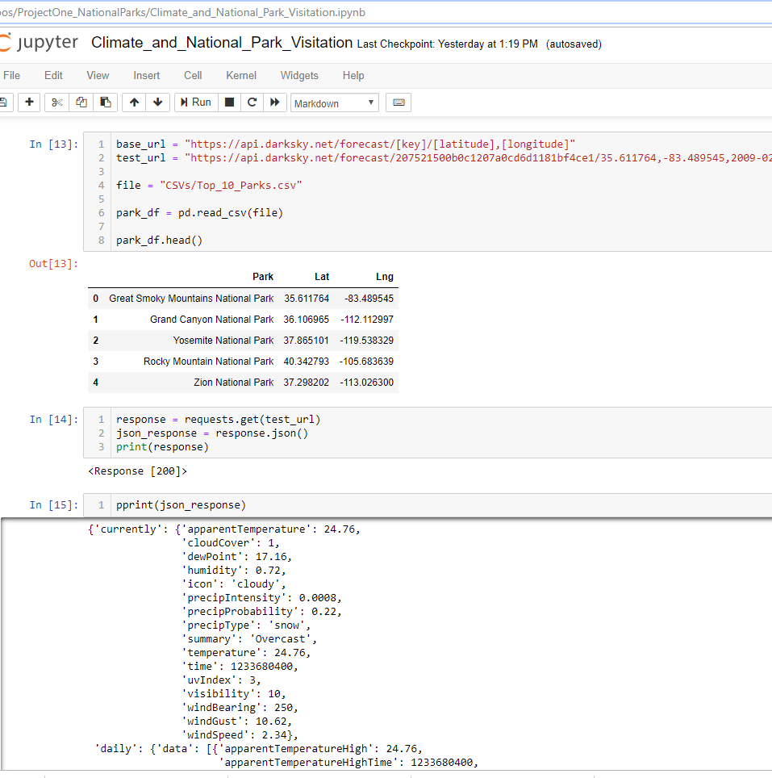
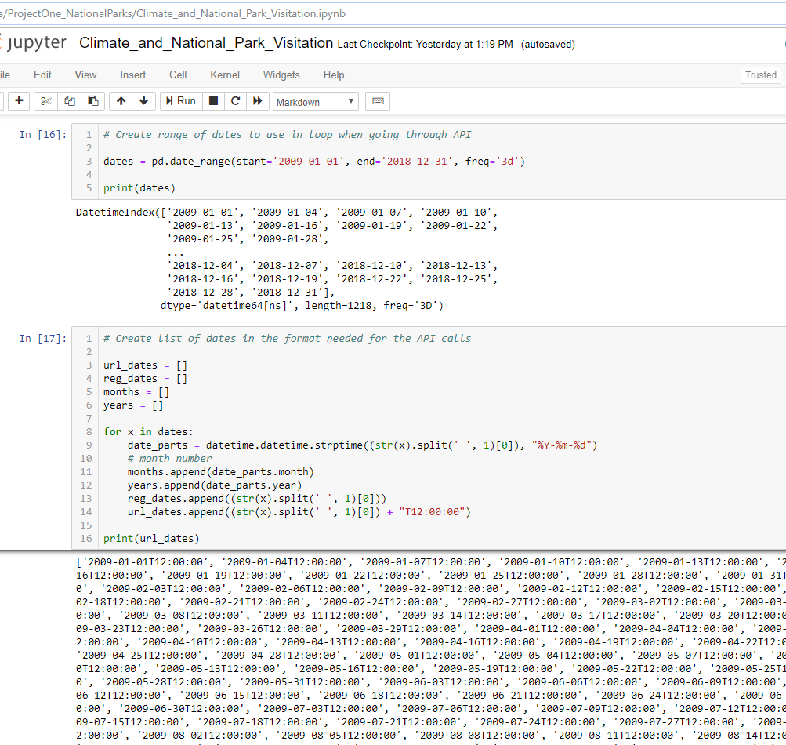
Step 6: Call Dark Sky API and get date format and create that date list for the API calls
Notes:
Nick

Slide 12
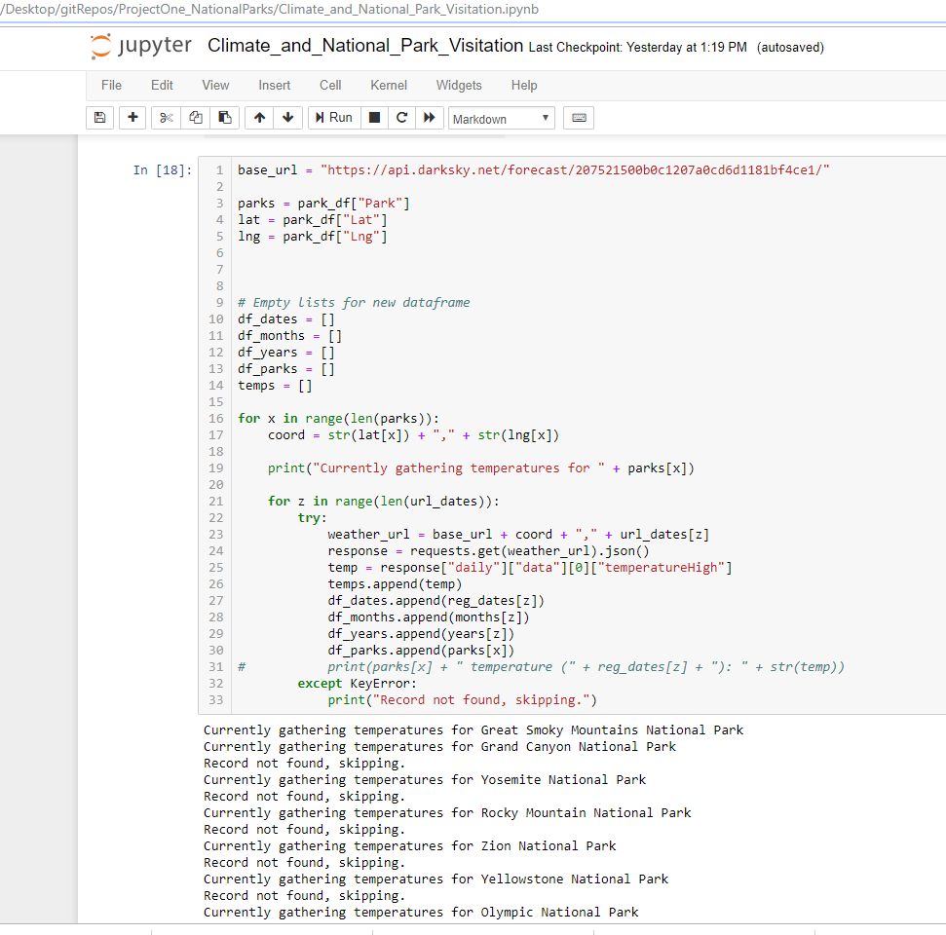
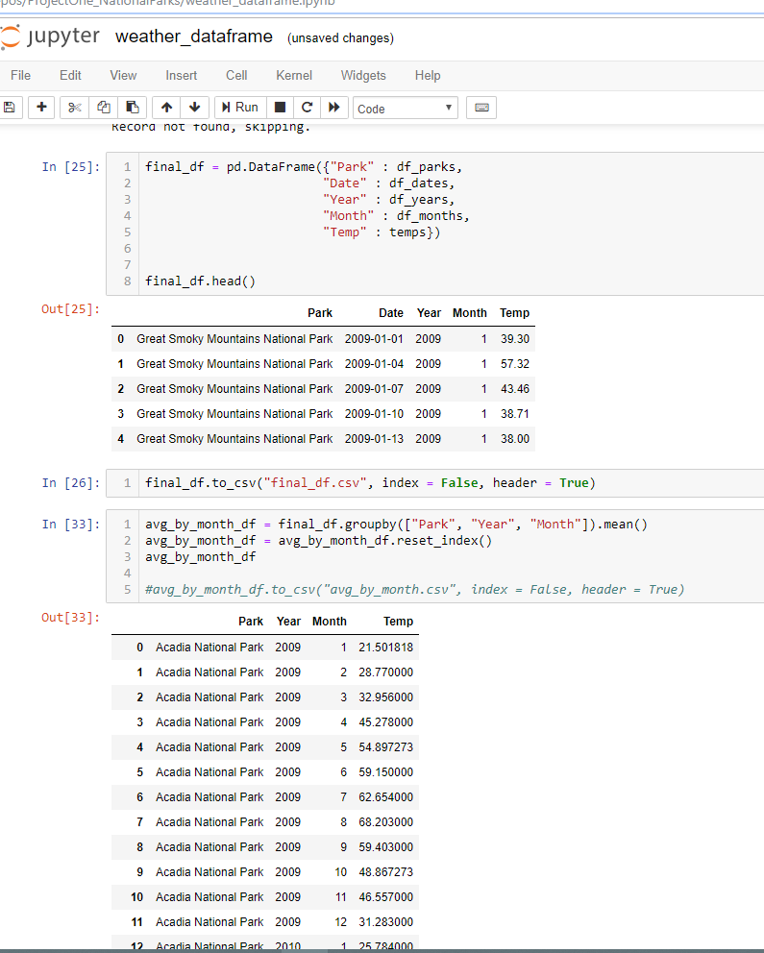
Step 6: Continued – Call Dark Sky API and return all temps for last 10 years at all locations
Notes:
Nick

Slide 13
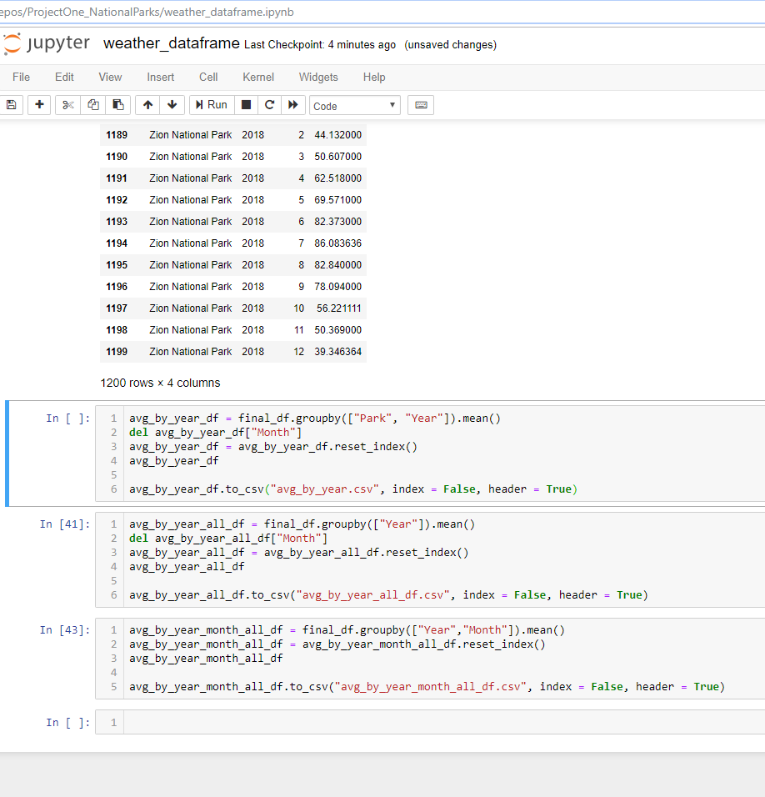
Step 7: Create GroupBy objects that calculate AVG temps and output to CSV for future use
Notes:
Nick

Slide 14
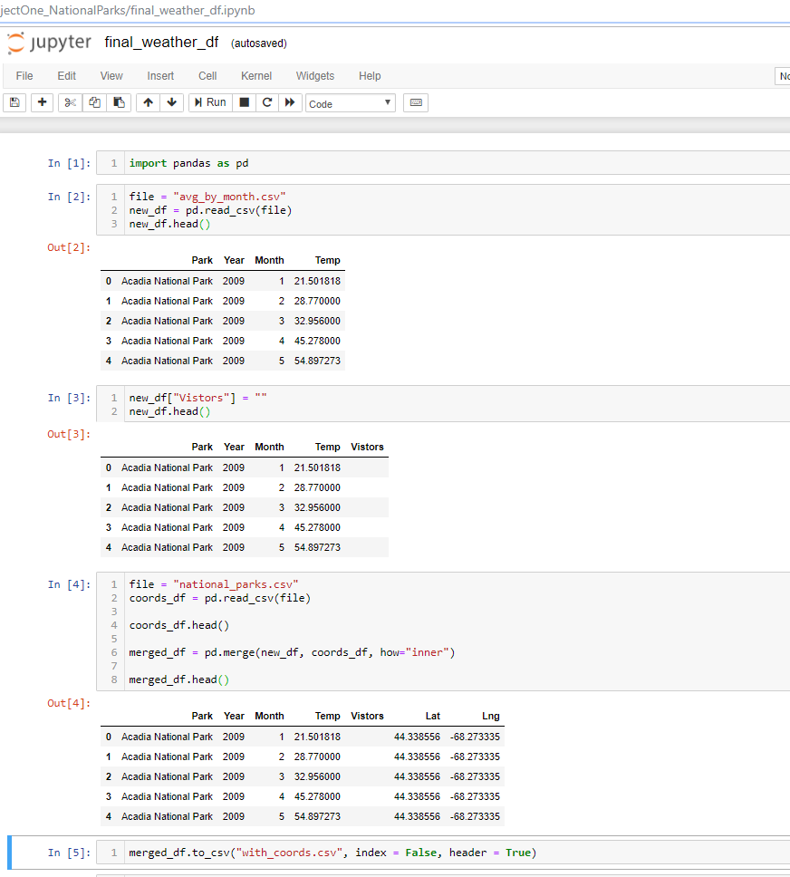
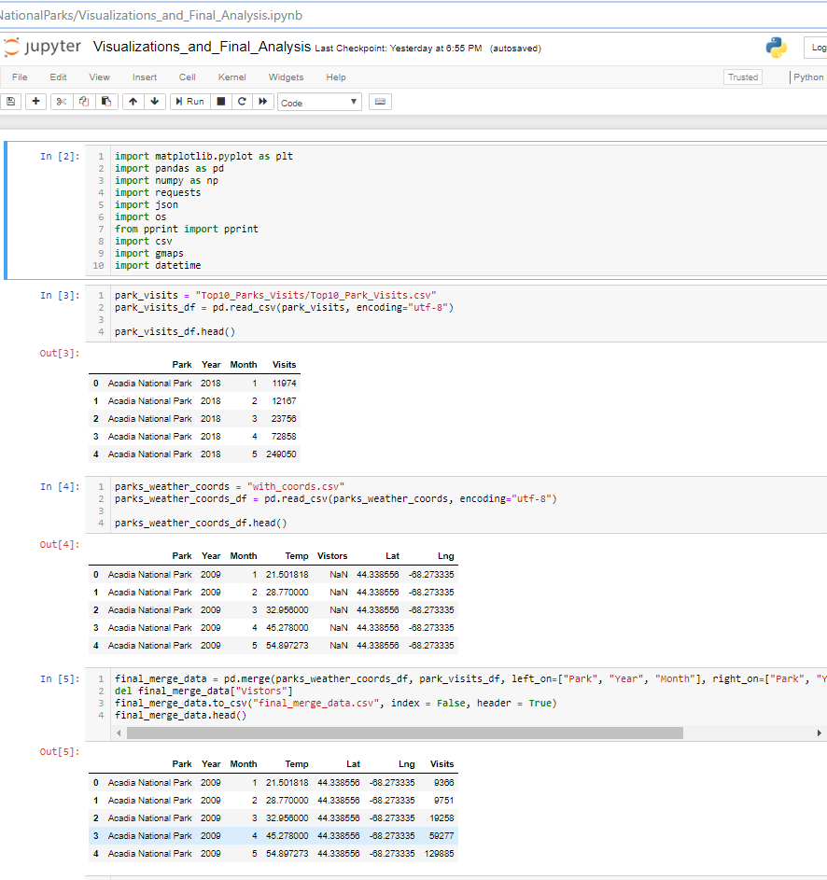
Step 8: Combine all data for locations, historic temps, and historic visitors into one data frame
Notes:
Andy

Slide 15
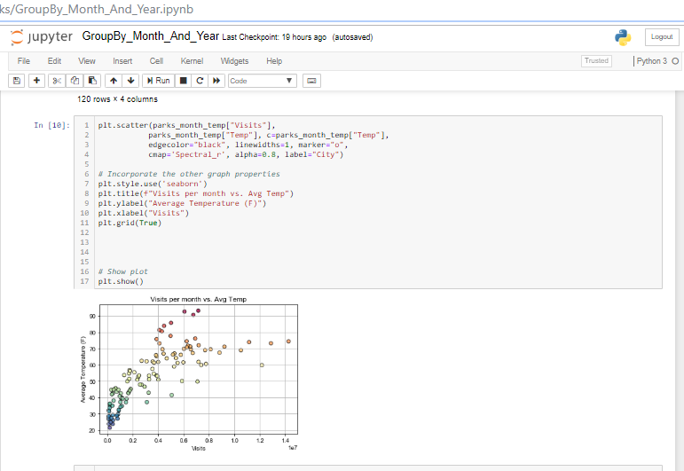
Step 9: Using GroupBy month create data frames and generate preliminary visualizations
Notes:
Tony

Slide 16

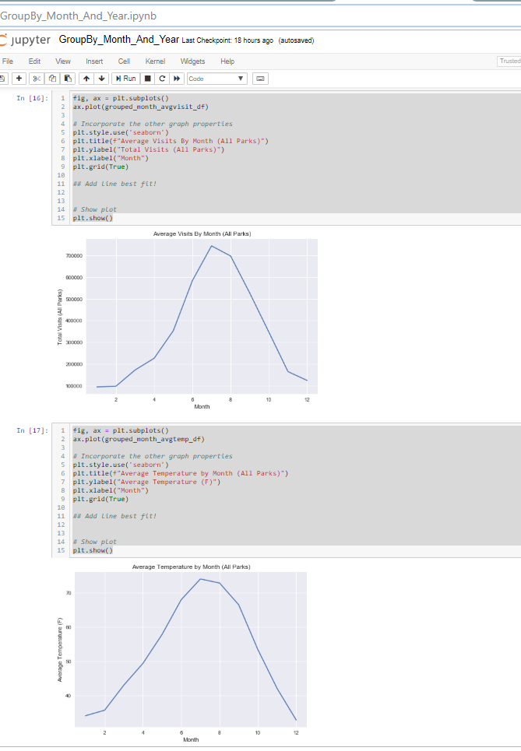
Step 9: Using GroupBy month create data frames and generate preliminary visualizations
Notes:
Tony

Slide 17
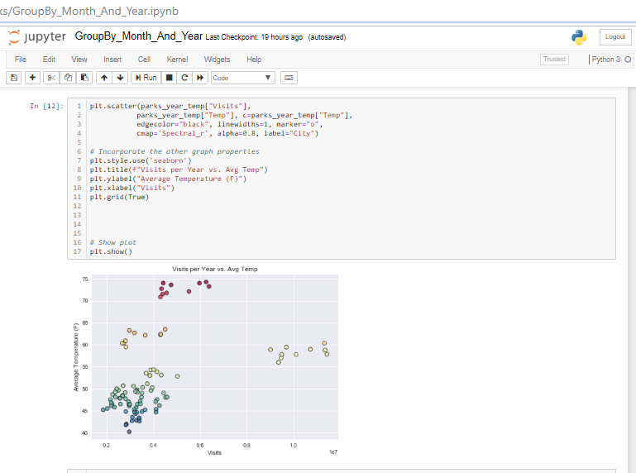
Step 9: Using GroupBy year create data frames and generate preliminary visualizations
Notes:
Andy

Slide 18
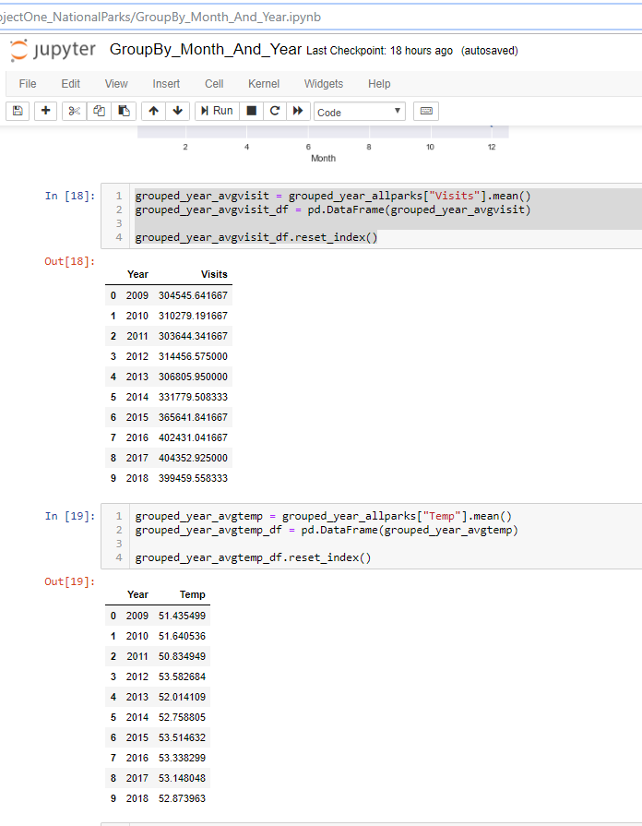
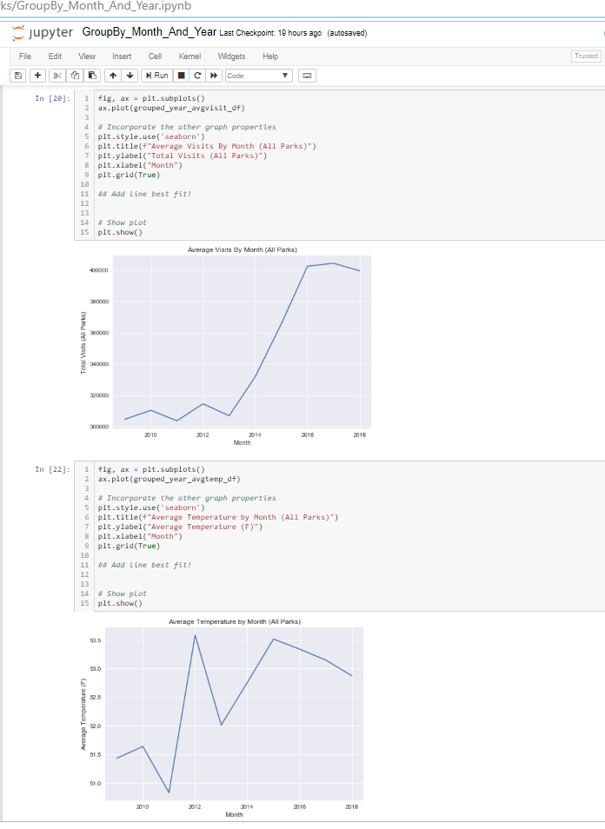
Step 9: Using GroupBy year create data frames and generate preliminary visualizations
Notes:
Andy

Slide 19
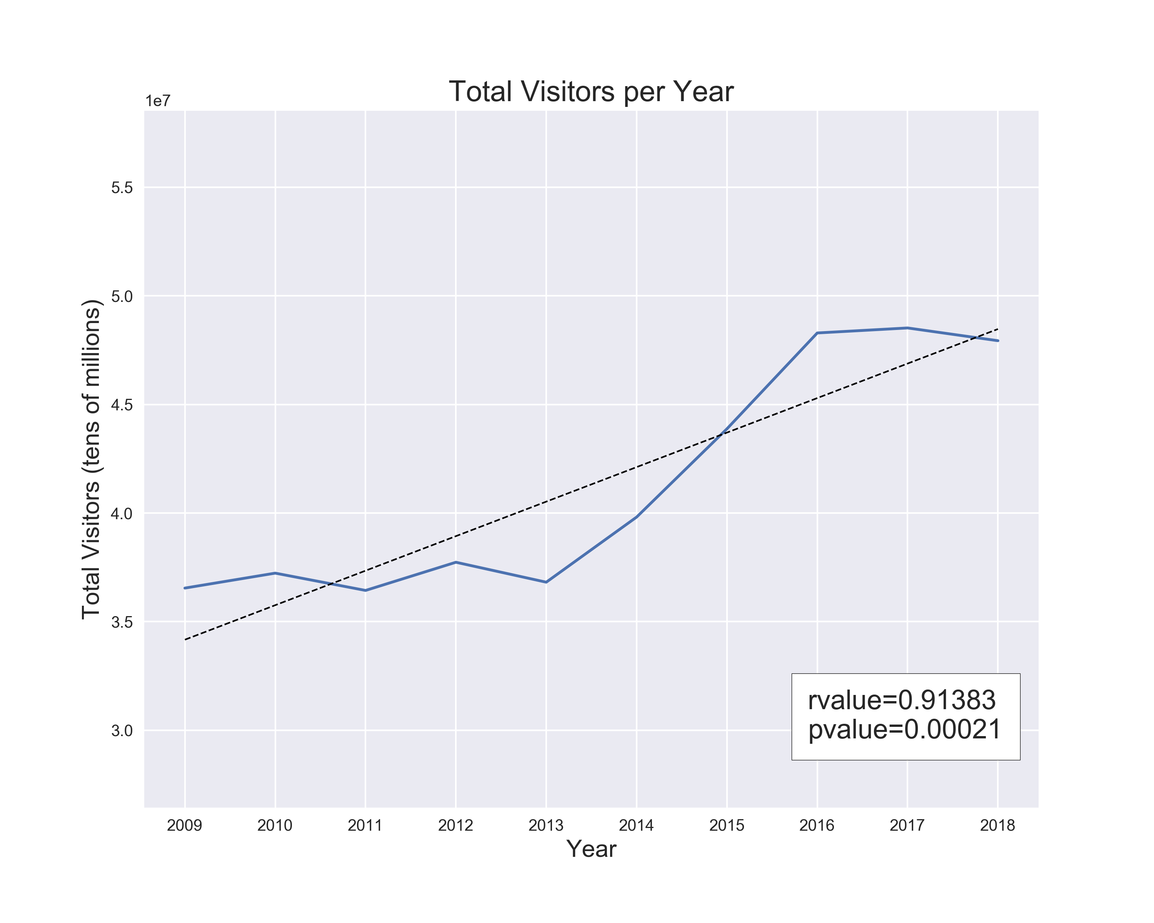
Through our research we found that visitors to the top 10 most frequently visited National Parks has increased by ~31% (1.59M more visitors per year) the last 10 years
Notes:
Kevin

Slide 20
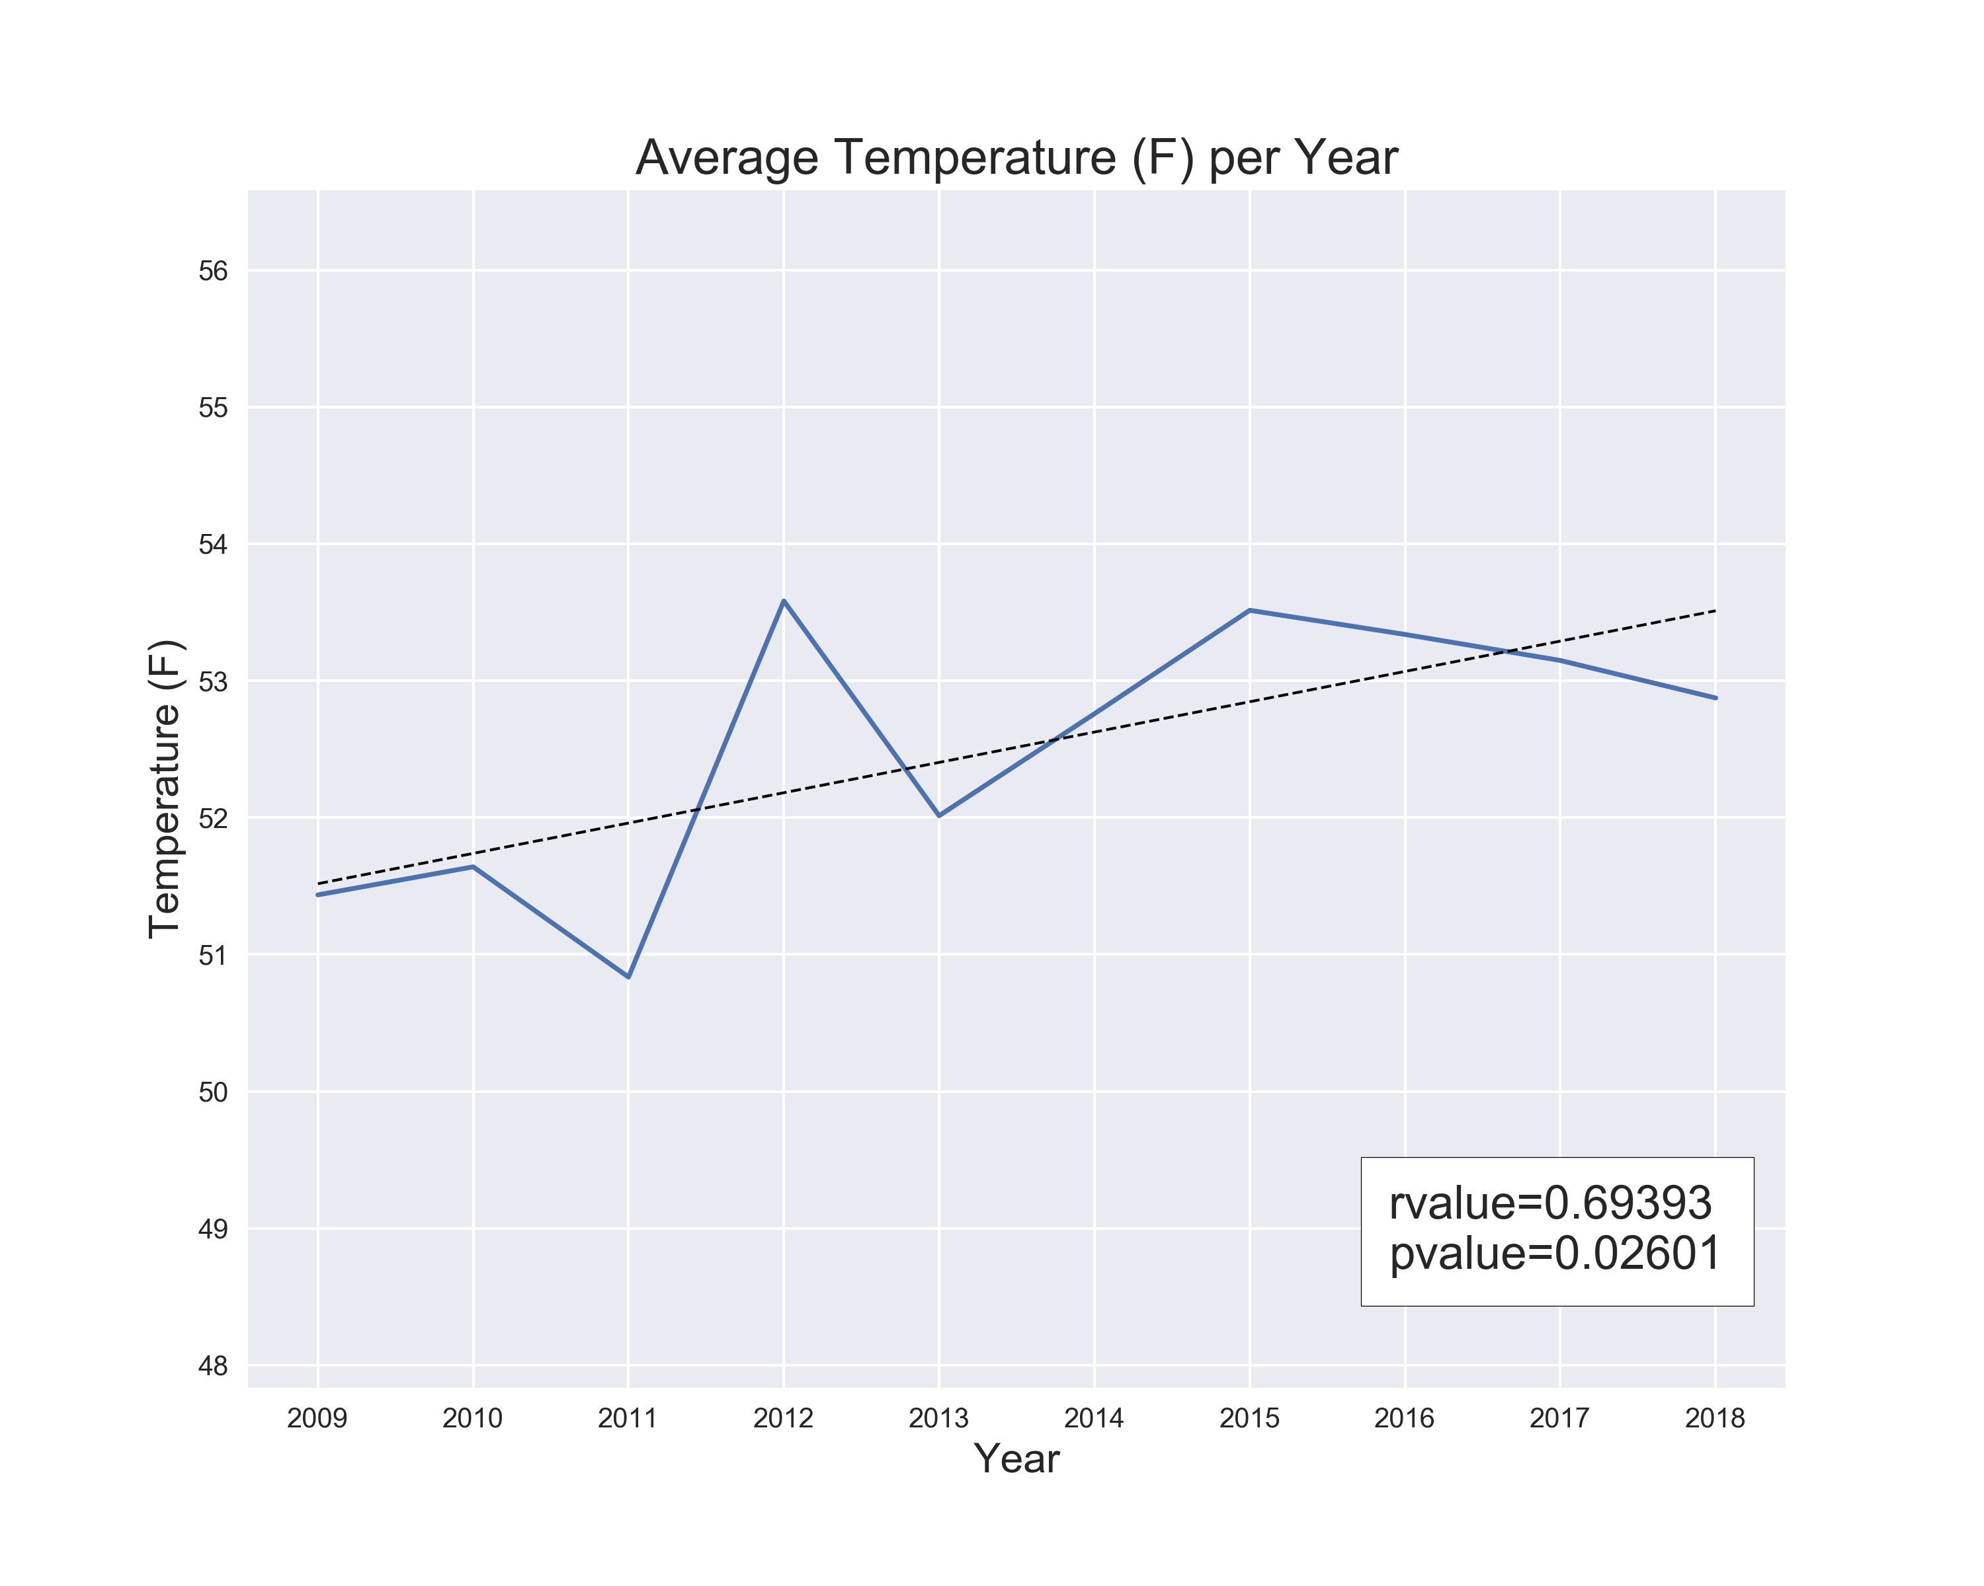
Through our research we also found that the average annual temperature for these 10 parks has increased by 2.2 degrees (~.22 degrees per year) over the same time period.
Notes:
Andy

Slide 21
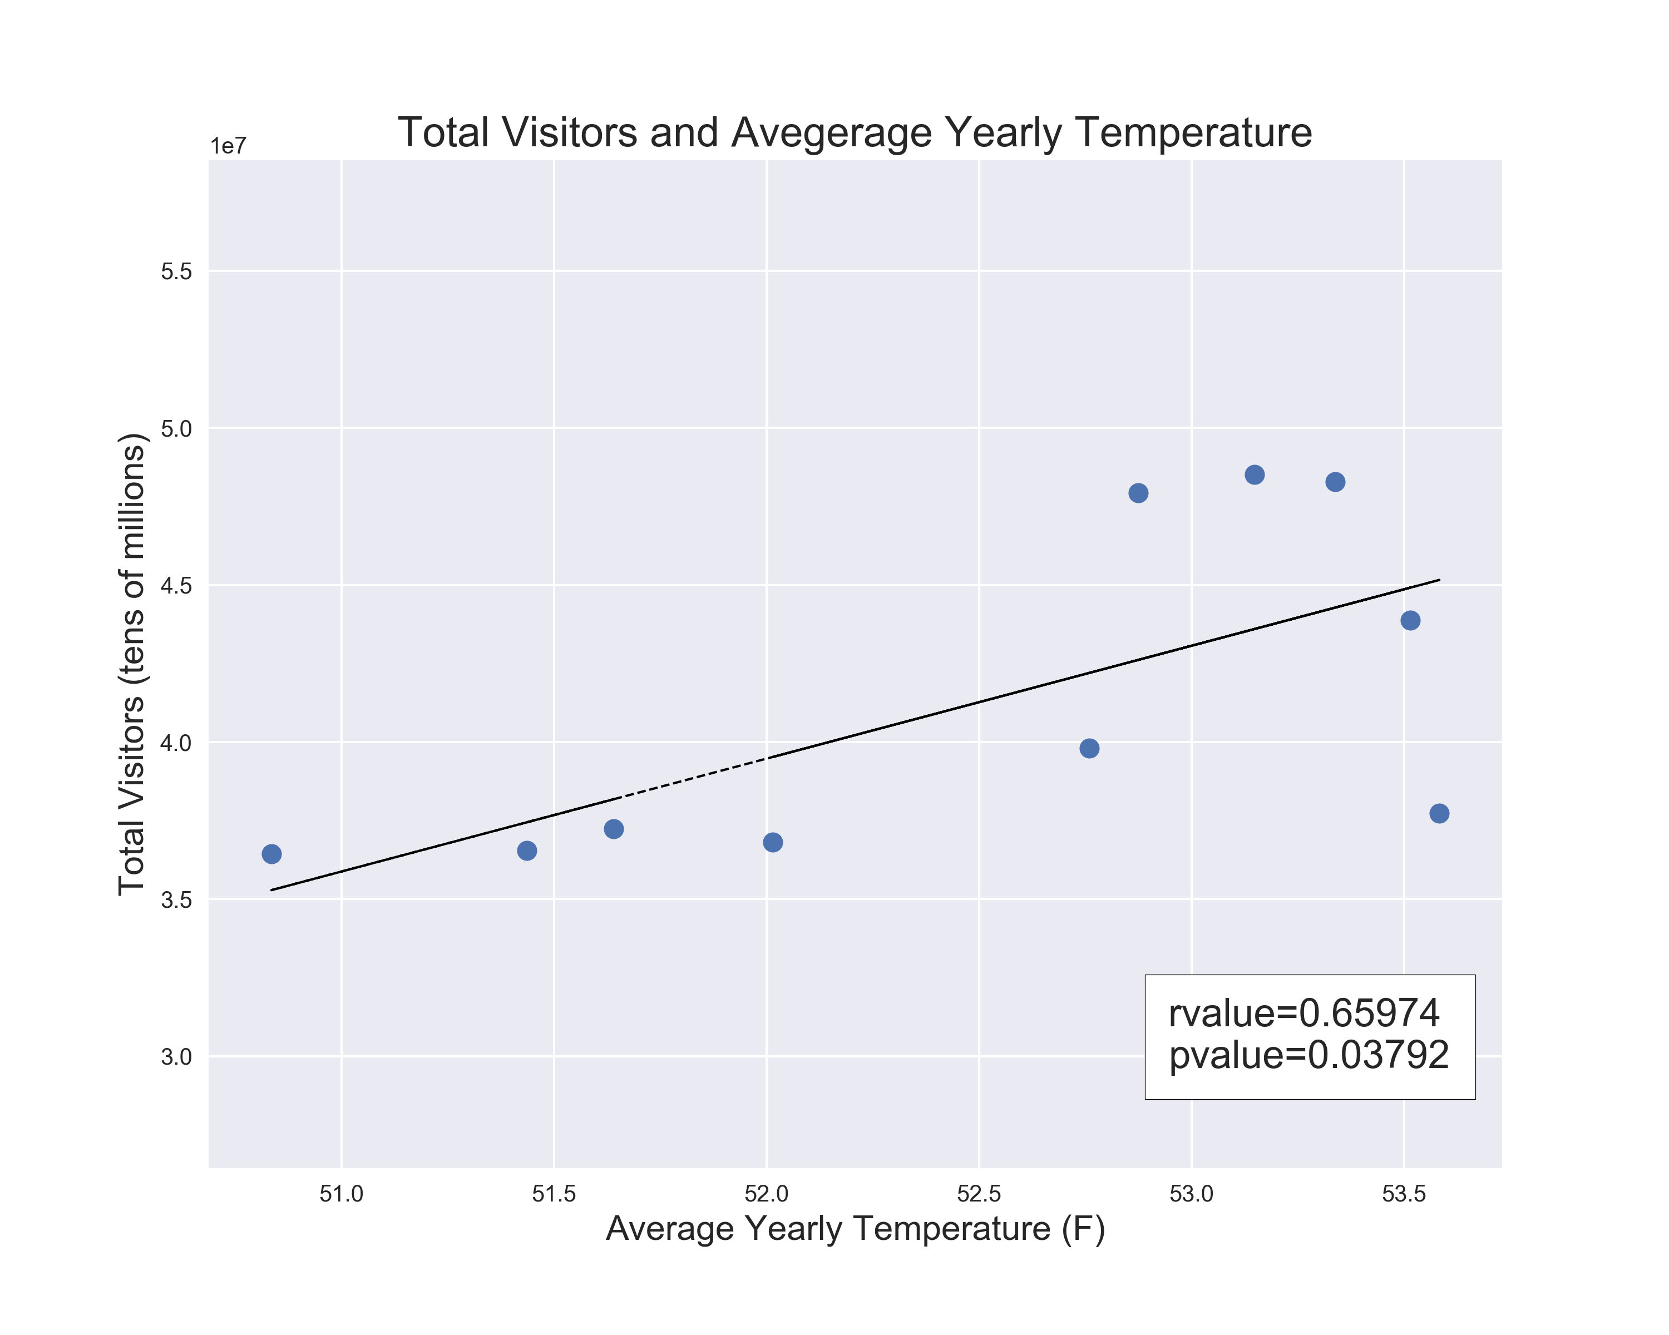
In conclusion we found that there is a statistically significant correlation between the average annual increase in visitors and the average annual increase in temperature at our nations top 10 most frequently visited parks
Because of this we had to reject our null hypothesis
Notes:
Nick

Slide 22
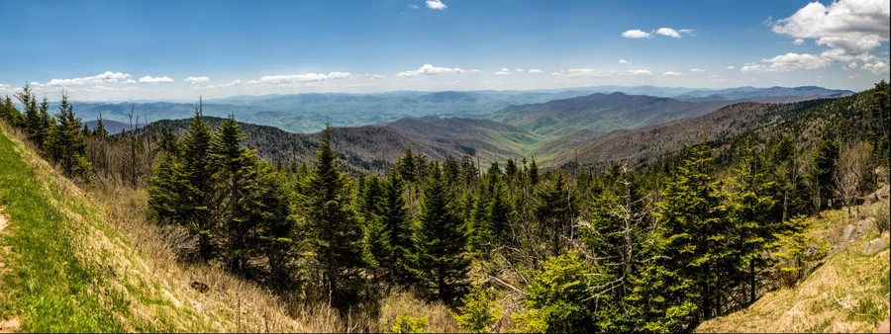

Park geography was fairly homogeneous when narrowed to 10 most visited parks
Weather API cost $ and we had to limit the total number of days that we pulled
Also needed to limit to 10 parks to reduce API calls and cost…originally we wanted to do all 58
We initially thought the Parks API had historic visitor information. But, we had to use a their IRMA portal to manually pull down CSV files of historic visitors – very time consuming
Notes:
Tony

Slide 23
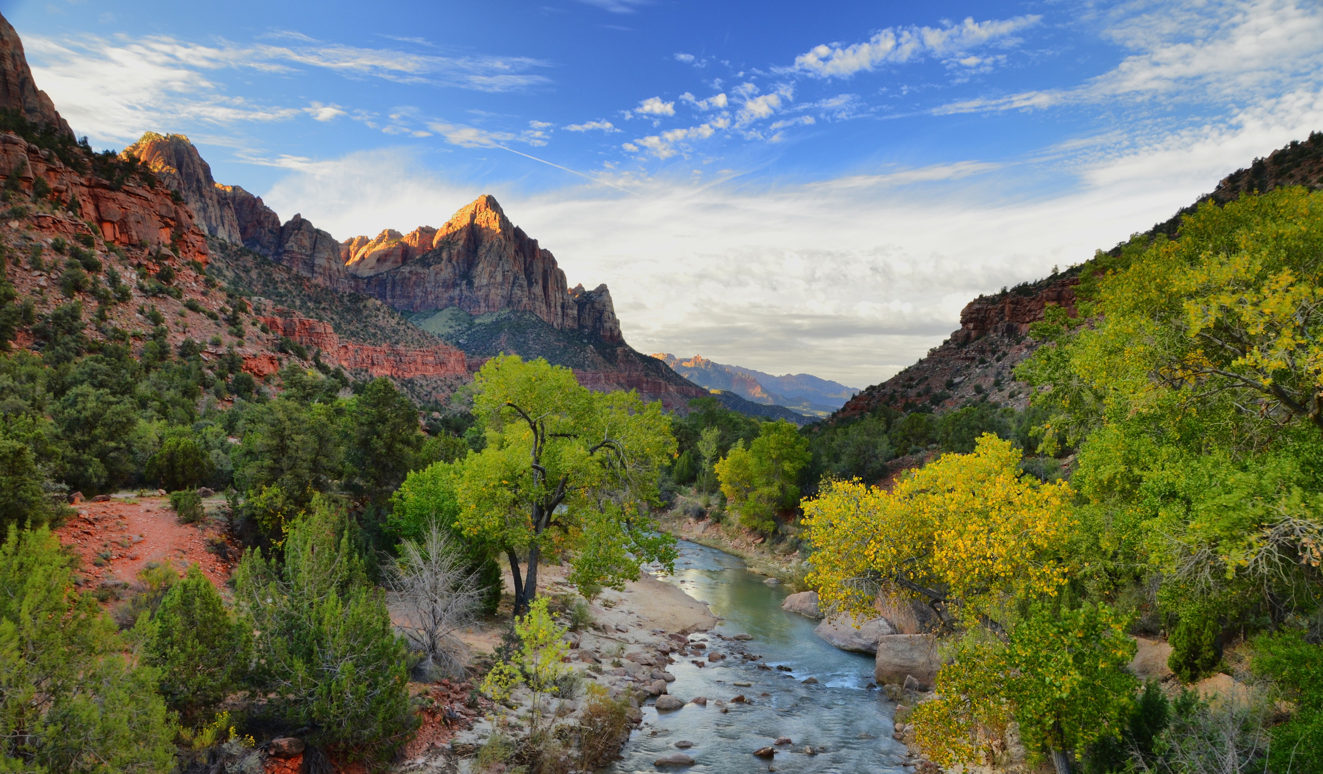

What would the weather trend at these locations look like over the last 50 years?
Or more?
Is that information available anywhere?
What would the results look like if we used all 58 parks instead of 10?
Again, over a significantly longer period of time
Would we expand to include national forests or other smaller parks to get a better sample?
Should we have been looking at global temperature change over 10 years or more?
Notes:
Andy

Slide 24
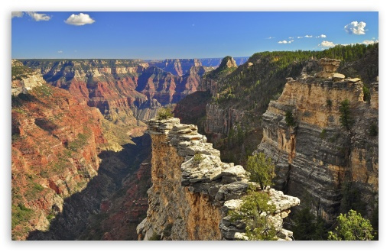
Notes:
ALL

